Slide 1
Software Engineering Agile XP & Kanban and DevOps
CS 1530
Summer 2020
Instructor: Sohel Sarwar
University of Pittsburgh
Lecture 3

Slide 2
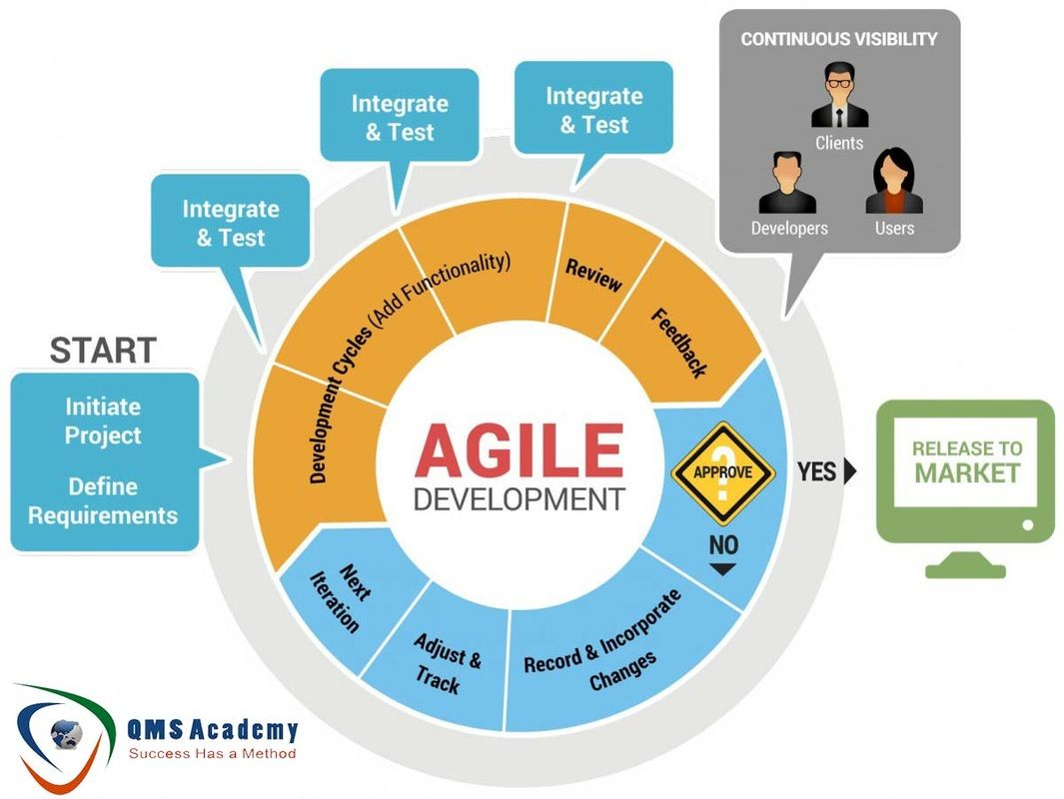
Software Engineering Software Development Methodology – Agile
SCRUM
XP (Extreme Programming)
KANBAN

Slide 3
Software Engineering Agile SCRUM
Scrum is a project management methodology, which was developed early 90s.
In simple terms, Scrum breaks down organizations into small, self-organizing teams. These teams then break the features they’ve been tasked with delivering down into small, manageable items of work which they tackle in time-boxed iterations called sprints.
Scrum is a tool used to organize work into small, manageable pieces that can be completed by a cross-functional team within a prescribed time period (called a sprint, generally 2-4 weeks long).
Source: https://www.scrum.org/resources/blog/scrum-and-extreme-programming-xp

Slide 4
Software Engineering Agile SCRUM
Scrum insists that teams comprise of three distinct roles:
Product Owner: responsible for initial planning, prioritizing, and communication with the rest of the company.
Scrum Master: responsible for overseeing the process during each sprint.
SCRUM Team: responsible for carrying out the design, coding, and testing.

Slide 5
Software Engineering Agile SCRUM
There are also four prescribed meetings in Scrum:
Sprint Planning Meeting
Daily Stand Up
Sprint Review
Sprint Retrospective

Slide 6
Sprint: A Sprint in Scrum is not a release cadence but a planning cadence. Scrum allows Sprint duration to be 2 weeks to one month. XP allows Sprint duration to be 1 week.
Product Backlog: Scrum requires the Product Backlog to be transparent as it is the single source of truth for any changes made to the product. XP teams write User Story. Writing the Product Backlog in stories is helpful for the team because stories is from the user perspective.
Sprint Backlog: The Sprint Backlog is user stories selected during Sprint Planning along with the tasks to complete those stories within a given Sprint.
Definition of Done: Scrum just tell us that the increment delivered by the development team to be "Done" every Sprint, and done means meeting the Scrum Team's definition of "Done". For some people Acceptance Criteria is the definition of "Done".
Software Engineering Agile
SCRUM Artifacts
Source: https://www.scrum.org/

Slide 7
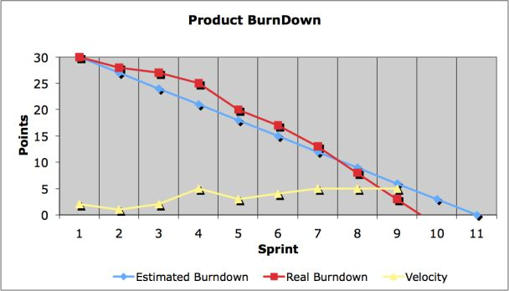
Software Engineering Agile
SCRUM Charts
Source: https://www.scrum.org/

Slide 8
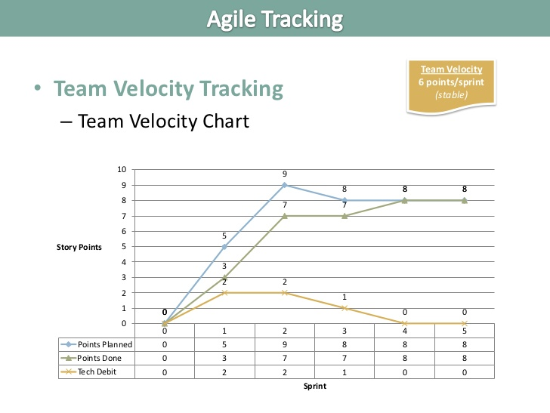
Software Engineering Agile
SCRUM Charts
Source: https://www.scrum.org/

Slide 9
Software Engineering Agile - XP
XP is short for eXtreme Programming, a framework which focuses heavily on ensuring the quality of delivered software and which prescribes engineering solutions towards that end.
An XP team (comprised of all who contribute to the project) engages in Release Planning and Iteration Planning.
They work in very short development cycles so that changes requested by the customer (who works on-site with the team) can be incorporated frequently.
Source: https://www.scrum.org/resources/blog/scrum-and-extreme-programming-xp

Slide 10
Software Engineering Agile - XP
Through more than a dozen core practices which include Test Driven Development, Customer Testing, Continuous Integration, Small Releases and Pair Programming, XP works towards a continuously improving, high quality product which can respond to changes in customer requirements.
Source: https://www.scrum.org/resources/blog/scrum-and-extreme-programming-xp

Slide 11
Software Engineering Agile - Kanban
Kanban was developed as a subcomponent of the Toyota Production System and has its origins in these Lean and Just In Time (JIT) manufacturing processes.
Source: https://www.scrum.org

Slide 12
Software Engineering Agile - Kanban
Kanban is also a tool used to organize work for the sake of efficiency. In Kanban the workflow is visualized by breaking the job down into small, discrete items and written on a card which is stuck to a board; the board has different columns and as the work progresses through different stages (e.g. ready, in progress, ready for review etc) the card is moved accordingly.
Source: https://www.scrum.org

Slide 13
Software Engineering Agile - Kanban
Where Scrum limits the amount of time allowed to accomplish a particular amount of work (by means of sprints), Kanban limits the amount of work allowed in any one condition (only so many tasks can be ongoing, only so many can be on the to-do list.)
Source: https://www.scrum.org

Slide 14
Software Engineering Agile - Kanban
In Kanban the number of items that can be in progress at any one time is strictly limited.
The average time it takes to complete an item (sometimes called the ‘cycle time’) is tracked and optimized so that the process becomes as efficient and predictable as possible.
The elimination of waste is paramount.
Source: https://www.scrum.org

Slide 15
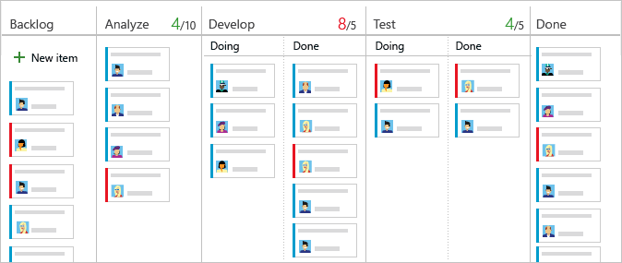
Software Engineering Agile - Kanban

Slide 16
Scrum is more prescriptive than Kanban, which eschews defining roles and teams and which has no formal structure of meetings. Kanban doesn’t prescribe iterations either – though they can be incorporated if desired.
The process visualization techniques of Kanban make it ideally suited to co-located teams who are working on a backlog of items that is subject to frequent change (for example, Kanban is often used by support teams).
The Kanban board though is often adopted by Scrum teams in the form of a task boardand is used to track progress throughout a sprint.
Software Engineering Agile
SCRUM VS KANBAN
Source: https://www.scrum.org/resources/blog/scrum-and-extreme-programming-xp

Slide 17
The limit to Work In Progress rule in Kanban also makes it suitable for teams with limited resources or where input from every member is required on each item. This could apply, for example, to a communications team within a large organization.
While Scrum limits the amount of work going into each sprint, the workload is determined by the relative estimation of the size of each story (in points) and is agreed by the Scrum team in each planning session.
Software Engineering Agile
SCRUM VS KANBAN
Source: https://www.scrum.org/resources/blog/scrum-and-extreme-programming-xp

Slide 18
While a Kanban team tracks ‘cycle time’ and optimizes for lead times that are as short and as predictable as possible, a Scrum team aims to improve its output over successive sprints and to improve the ‘velocity’ of the team (the number of relative estimation points completed in a sprint). This arguably makes Scrum more suitable for scaling – it certainly feels more familiar and predictable which can be reassuring for large organizations.
Software Engineering Agile
SCRUM VS KANBAN
Source: https://www.scrum.org/resources/blog/scrum-and-extreme-programming-xp

Slide 19
In Scrum, teams and meetings are fairly set in stone whereas the question of how work actually gets done is left to the teams to decide themselves. XP on the other hand comes with a set of core practices that could seem overwhelming to the Agile beginner.
It could be said that Scrum is a methodology, which is more concerned with productivity while XP is more concerned with engineering.
The value that XP practices can add though is undisputable and many organizations which use Scrum adopt Pair Programming, Test Driven Development and Refactoring as practices which improve quality, speed up the release process and/or reduce the need to revisit work due to technical debt.
Software Engineering Agile
SCRUM VS XP
Source: https://www.scrum.org/resources/blog/scrum-and-extreme-programming-xp

Slide 20
Alongside shorter iterations, some other important things which differentiate XP from Scrum are:
XP teams work on items in a strict priority order whereas a Scrum team might not necessarily tackle each item in priority order once in sprint
XP teams can bring new items of work into an iteration and switch out items of equivalent size (as long as they haven’t been started) if the customer decides on a new priority
Software Engineering Agile
SCRUM VS XP
Source: https://www.scrum.org/resources/blog/scrum-and-extreme-programming-xp

Slide 21
In terms of similarities, the role of the customer in XP is very similar to that of the Product Owner in Scrum – in that they help write user stories, prioritize them and are always available to developers – though less well defined.
Both Scrum and XP mandate a daily stand up meeting.
While both stress the importance of co-location, only XP makes it deal-breaker.
Software Engineering Agile
SCRUM VS XP
Source: https://www.scrum.org/resources/blog/scrum-and-extreme-programming-xp

Slide 22
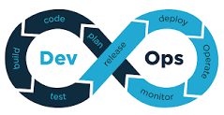
What is DevOps?
DevOps is a set of practices that works to automate and integrate the processes between software development and IT teams, so they can build, test, and release software faster and more reliably.
The term DevOps was formed by combining the words “development” and “operations” and signifies a cultural shift that bridges the gap between development and operation teams, which historically functioned in siloes.
Software Engineering DevOps
Source: https://www.atlassian.com/devops#history-of-devops

Slide 23
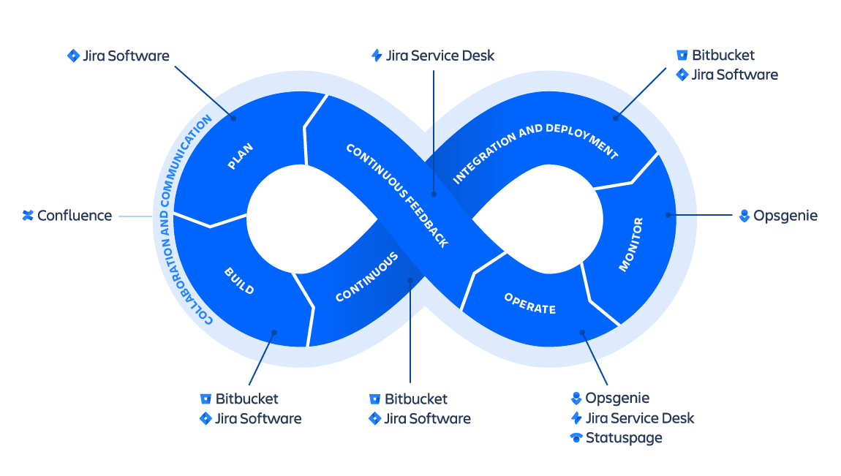
What is DevOps?
Software Engineering DevOps
At its essence, DevOps is a culture, a movement, a philosophy. It's a firm handshake between development and operations that emphasizes a shift in mindset, better collaboration, and tighter integration. It unites agile, git, continuous delivery, automation, and much more, to help development and operations teams be more efficient, innovate faster, and deliver higher value to businesses and customers.
Source: https://www.atlassian.com/devops#history-of-devops

Slide 24

A Common Pre-DevOps Scenario
The Dev team that has a goal to ship as many features as possible, kicks a new release “over the wall” to QA. Then the tester’s goal is to find as many bugs as possible. When the testers bring their findings to Dev, the developers become defensive and blame the testers that are testing the environment for the bugs. The testers respond that it isn’t their testing environment, but the developer’s code that is the problem.
Software Engineering DevOps
Source: https://resources.collab.net/devops-101/what-is-devops

Slide 25
A Common Pre-DevOps Scenario
Eventually the issues get worked out and QA kicks the debugged new release “over the wall” to Ops. The Ops team’s goal is to limit changes to their system, but they apprehensively release the code and the system crashes. The finger pointing resumes.
Ops says that Dev provided them faulty artifacts. Dev says everything worked fine in the test environment. The fire drills begin to debug the system and get production stable. The production environment isn’t Dev’s and QA’s responsibility, so they keep hands off while Ops spends all night fixing the production issues.
Software Engineering DevOps
Source: https://resources.collab.net/devops-101/what-is-devops

Slide 26
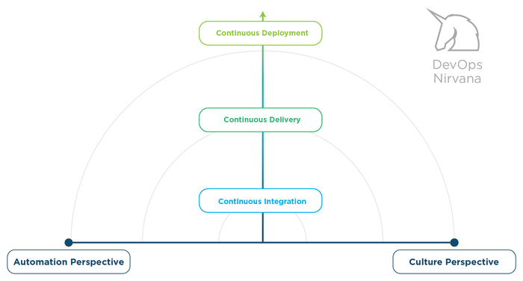
Where Are You on the DevOps Continuum?
The DevOps continuum is a helpful way to look at the different aspects of DevOps. The bottom horizontal axis represents what people perceive DevOps to fundamentally be focused on. Some people adamantly feel that DevOps should focus on culture more than tools, while on the other people tend to value tools over culture.
Software Engineering DevOps
Source: https://resources.collab.net/devops-101/what-is-devops

Slide 27
Where Are You on the DevOps Continuum?
The vertical axis depicts the three levels of the DevOps delivery chain: continuous integration, continuous delivery and continuous deployment. The DevOps community refers to organizations in the top right of the DevOps continuum as pink unicorns because there are currently so few of them that you don’t see them in the wild very often. Popular examples of these unicorns are companies like Netflix, Etsy, Amazon, Pinterest, Flicker, IMVU and Google. In a recent poll participants indicated where their organizations fit on the DevOps continuum:
Software Engineering DevOps
Source: https://resources.collab.net/devops-101/what-is-devops

Slide 28
What Is the Goal of DevOps?
Improve collaboration between all stakeholders from planning through delivery and automation of the delivery process in order to:
Improve deployment frequency
Achieve faster time to market
Lower failure rate of new releases
Shorten lead time between fixes
Improve mean time to recovery
According to the 2015 State of DevOps Report, “high-performing IT organizations deploy 30x more frequently with 200x shorter lead times; they have 60x fewer failures and recover 168x faster.”
Software Engineering DevOps
Source: https://resources.collab.net/devops-101/what-is-devops

